Slide 1
MezőStahl Mérnöki Iroda Kft. H-4233 Balkány Geszterédi út 1. tel.: 00-36-42-561-093
MezőStahl Kft.
Company presentation

Slide 2
MezőStahl Mérnöki Iroda Kft. H-4233 Balkány Geszterédi út 1. tel.: 00-36-42-561-093
MezőStahl Kft.
Our company was founded in 1992 in Balkány. Owners are the four members of Mező family. Mezőstahl Ltd. is divided to two companies: Mezőstahl Mérnöki Iroda Ltd. and Mezőstahl Hengerüzem Ltd. These two firmas work together and they both have the same owners. The company employs 60 people including manufacturing workers and office workers. The firma is located in Balkány, Hungary, 4233, Geszterédi street 1. The main activites of the company are roll forming, punching/bending, tool design and manufacturing and chipping. Mezőstahl Ltd. has ISO 9001:2015 certificate, so we pay attention to reach the best quality. The company’s turnover was 4.000.000 € last year.
Our bigger customers are for example Sematic Hungary, Wittur, HLF Heiss.
www.mezostahl.hu

Slide 3
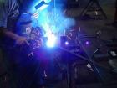
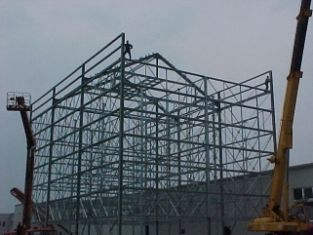
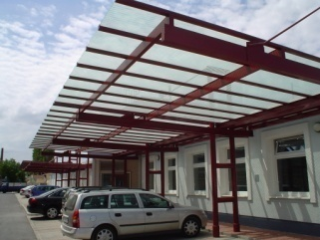
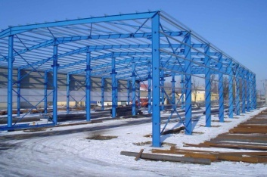
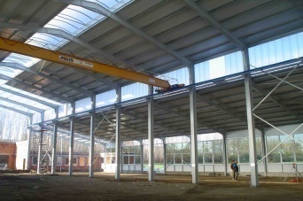
MezőStahl Mérnöki Iroda Kft. H-4233 Balkány Geszterédi út 1. tel.: 00-36-42-561-093
Steel Constructions
Leading-edge technologies designed factory buildings and production of steel-framed structures.
Our steel constructions adjust for the costumer’s needs. These structures can be made of lattice, solid and segmented varying cross-welded plate design. Materials that we use are the following: tube, pipe tube, euro-sections and plates. Our company has type plans, which are the followings:
10m; 12m; 15m; 18m; 21m; 24m span. Corrosion protection: according to traditional painting or
hot dip galvanizing.
But nowadays this isn’t the activity that we pay attention the most for.
www.mezostahl.hu

Slide 4
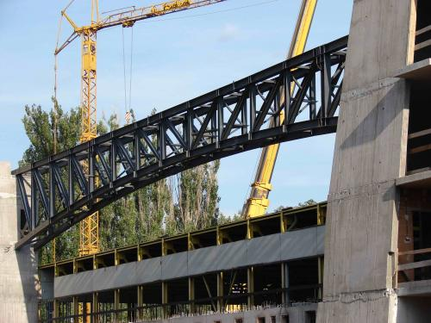
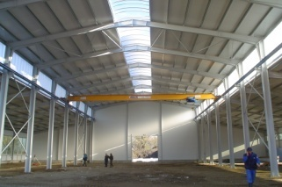
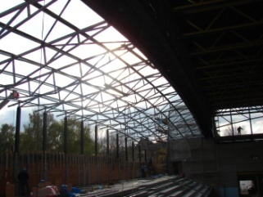
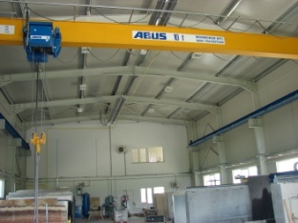
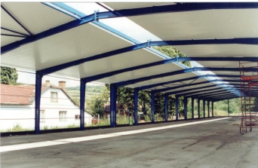
MezőStahl Mérnöki Iroda Kft. H-4233 Balkány Geszterédi út 1. tel.: 00-36-42-561-093
Steel Constructions
Our bigger jobs
Auchan's logistics center 36 000m²
San Benedetto mineral water bottling 10 000m²
Benetton factory16 000m²
Renovation of Sports Hall of Kecskemet
www.mezostahl.hu

Slide 5
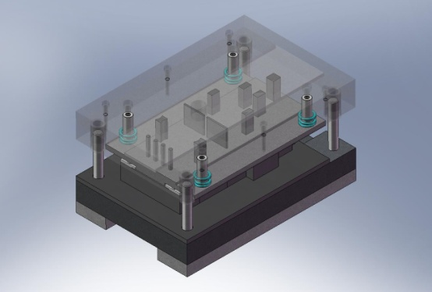
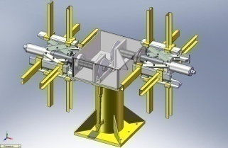
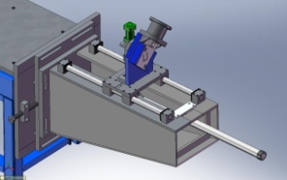
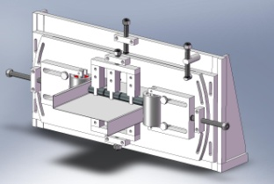
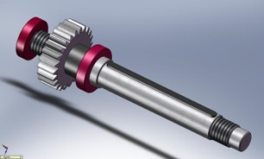
MezőStahl Mérnöki Iroda Kft. H-4233 Balkány Geszterédi út 1. tel.: 00-36-42-561-093
Planing
Our projects are using computer to design a strong capacity. The production is accurate, transparent, and especially fast design phase is preceded by using various dedicated software. This is actually a response to modern demands.
The professional team used special machines rolling and cold-forming tools required for the manufacture of metal products design and manufacture is done within the company. For desinging we use SolidWorks and AutoCad softwares. SolidWorks computer-aided design system allows complete assembly of lines and components that we apply are high standards modeled. SolidWorks assembly environment enables accurate modeling of parts to fit together.
www.mezostahl.hu

Slide 6
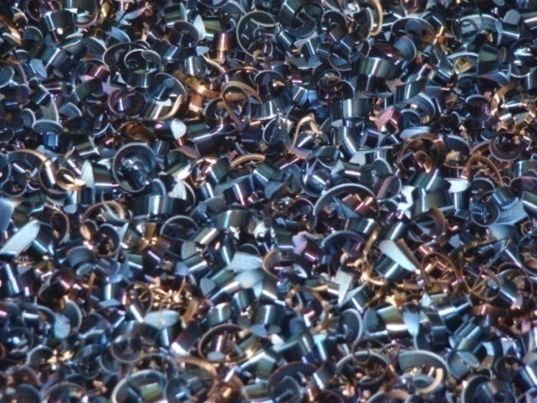
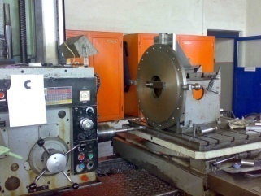
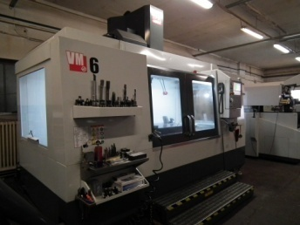
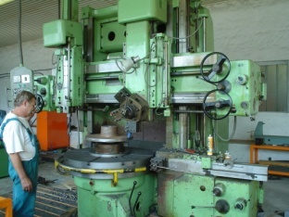
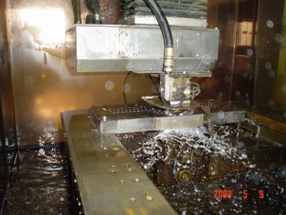
MezőStahl Mérnöki Iroda Kft. H-4233 Balkány Geszterédi út 1. tel.: 00-36-42-561-093
Chipping
Our chipping department, according own desing, different cold-forming tools and devices, purpose machines we produce for own use and production.
In 1999, we were able to develop a modern chipping plant. For further development, we managed to obtain all the metal cutting machine, which is required in today's modern mechanical engineering and tool and device manufacturing. In our chipping plant we make unique parts by their own design. In all cases, all parts are subjected to strict quality control. The tool production, in addition to the traditional cutting machines available consists of two wire EDM, an EDM machine and a CNC lathe.
Last years we invested in a HAAS VM 6 machining center.
www.mezostahl.hu

Slide 7
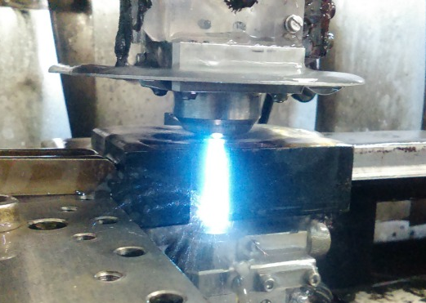
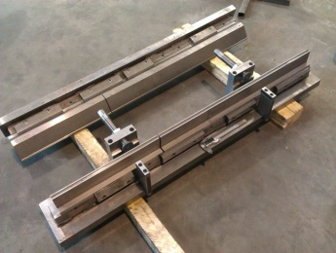
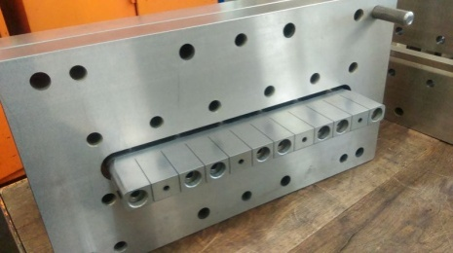
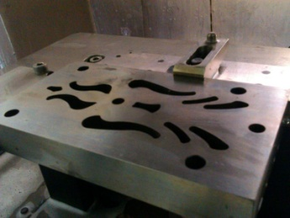
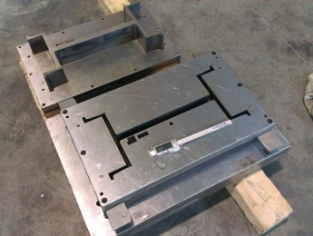
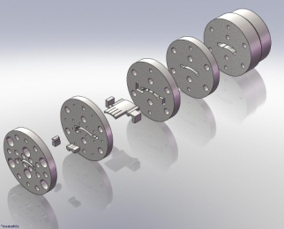
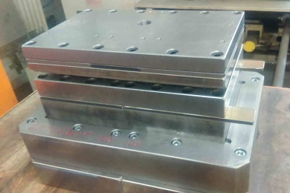
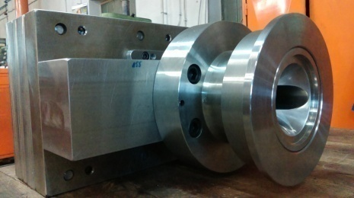
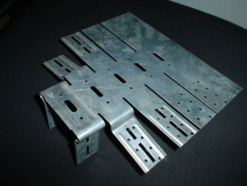
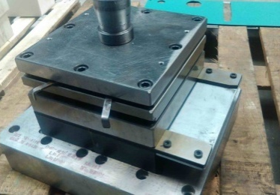
MezőStahl Mérnöki Iroda Kft. H-4233 Balkány Geszterédi út 1. tel.: 00-36-42-561-093
Tool Design and Construction
For the tool design our engineer performed AutoCad and Solidworks softwares. For our tools we use several tool part manufacturer's products in European firms, such as: Hasco, Kern, Strack, and we use only high quality materials. We prepared the 400th self-designed tool in the beginning of the year 2016.
www.mezostahl.hu

Slide 8
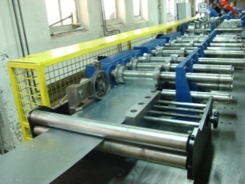
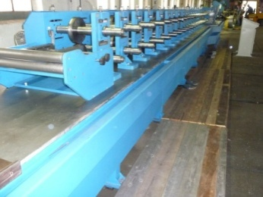
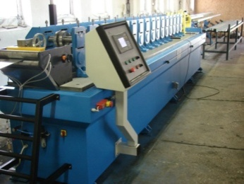
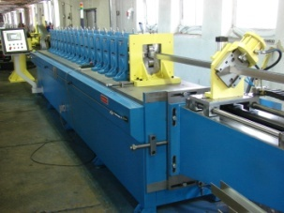
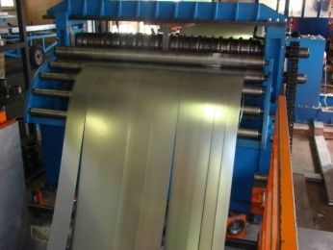
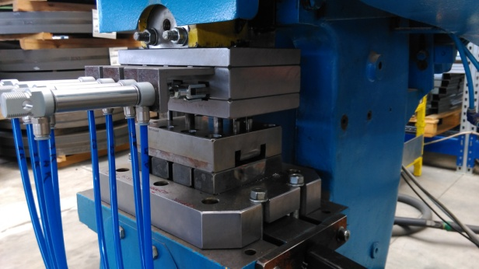
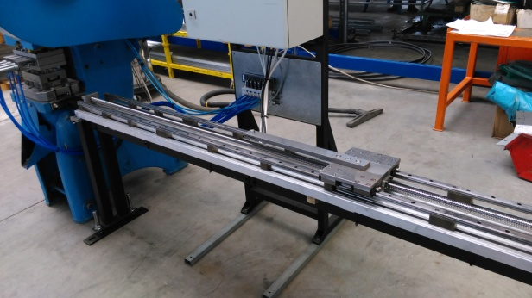
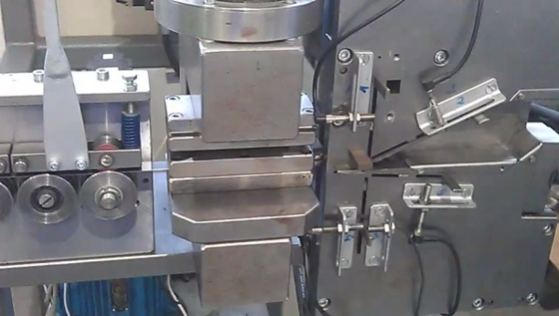
MezőStahl Mérnöki Iroda Kft. H-4233 Balkány Geszterédi út 1. tel.: 00-36-42-561-093
Purpose machines
We take the philosophy that we can be manufactured in-house, such as roll formings and purpose machine production within 90% of the company, from design manufacturing to the controller. Over the years, six roll forming lines and a splitting machine manufactured.
In addition to complete machines, we produce target machines for our manufacturing. We have been trying to eliminate the human factor in the operation of the machine design phase, that is for automating as much as possible.
www.mezostahl.hu

Slide 9
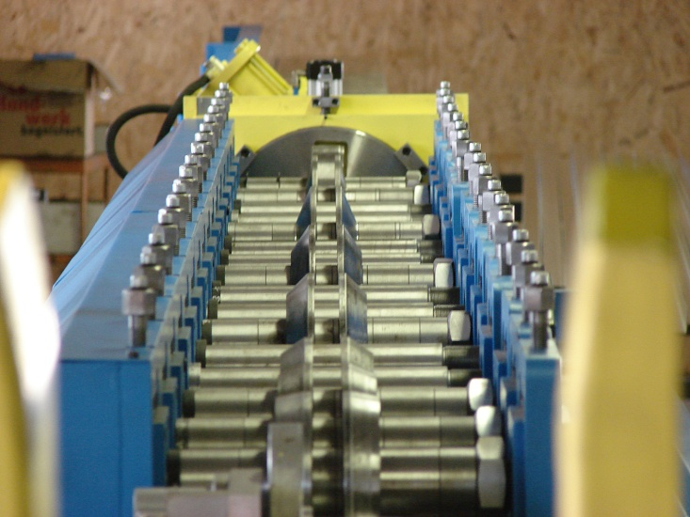
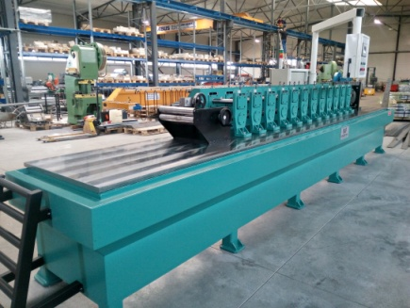
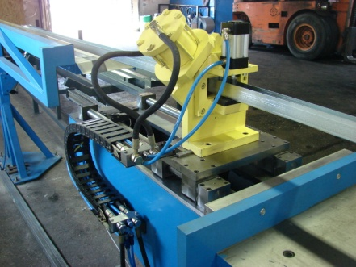
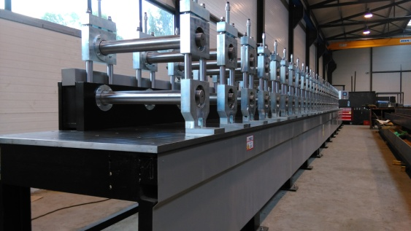
MezőStahl Mérnöki Iroda Kft. H-4233 Balkány Geszterédi út 1.
Roll forming
We use modern profile forming machines, on which the development of fully customized profiles are also available.
Our company use Roll Forming System since 2004. We continually expand our profile range. We undertake new profiles making, in 3mm thickness and 850mm unpolded size. Rolled products include all kinds of gypsum profils used in drywall construction, different U, G, J profiles for supporting of plastic windows and doors, used in steel constructions building Z and C purlins, furthermore vineyard, shelving systems and mounting what is used in the air technology.
www.mezostahl.hu

Slide 10
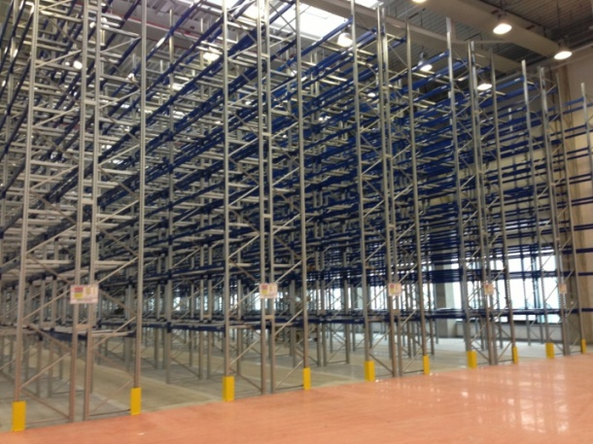
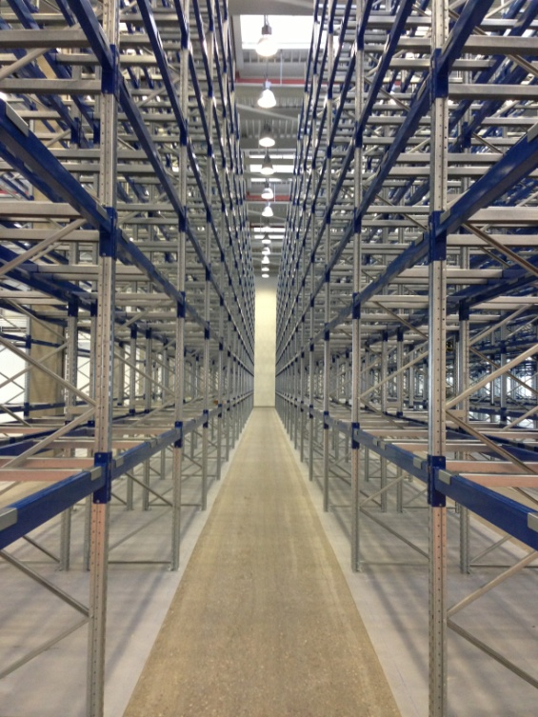
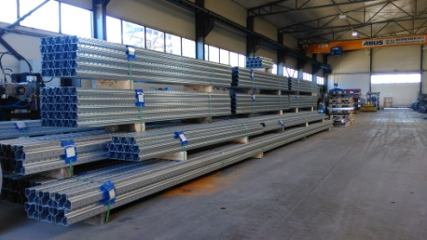
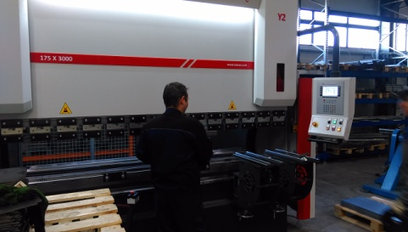
MezőStahl Mérnöki Iroda Kft. H-4233 Balkány Geszterédi út 1. tel.: 00-36-42-561-093
Roll forming
References
Shelving systems (HEISS, UNIX)
All kinds of gypsum profils (Knauf)
Supporters of plastic window and door
Z-C purlins
Individual profiles for unique orders
www.mezostahl.hu

Slide 11
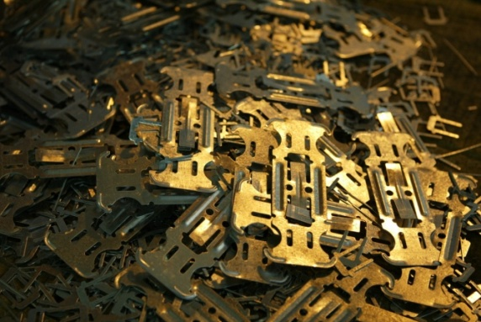
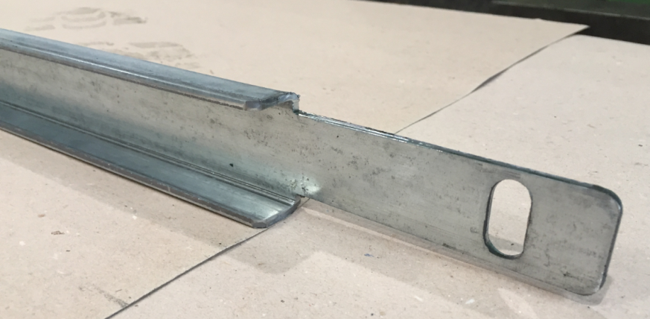
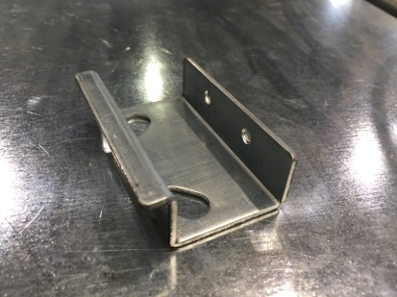
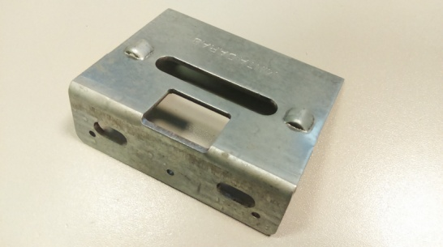
MezőStahl Mérnöki Iroda Kft. H-4233 Balkány Geszterédi út 1. tel.: 00-36-42-561-093
Punching
In the area of basic metal manufacturing we have more than 20 years of experience. Our capacity continues to grow. Own tool manufacturing plant guarantee the manufacturing continuity of basic metal, so our partners are in the respective security. If necessary, our products can be analized by EMI. For the production we use eccentric presses with 1-250t compressive force.
Main customers
Sematic Hungária Kft.
HLF Heiss
Unix Autó
Wittur company
Monier
Bau-System
Lambda System
www.mezostahl.hu

Slide 12
Our investments
Investments in 2016
DENER CNC Bending Machine with 5-axis 3000mm, 160 t
MRF850-18 Roll Forming line
Investments in 2014
1650 m2 pressing and slitting plant
MRF550-24 Roll forming machine
Compactor were purchased 250t; 100t; 63t; 50t
Investments in 2015
1050 m2 smith plant for steel construction
Renovation of DKS100 and LEN160 compactor
ERP system expansion
(Kulcs Ügyvitel Prémium)
Plastic extruder tools manufacturing
Investments in 2017
Demolition of old factory hall, new factory hall extension in 1000m2
HAAS VM 6 machining center
Mitsubishi CNC wire cut machine
2016 HR development:
Sematic Key Account
Electronic technician
Qualiry manager
Investments in 2018
Camion for transporting

Slide 13
Competitions
For our investments and developments we apply for the competitions of European Union. We have successfully completed and on going projects. We won HUF 110 million (EUR 353 000) non-refundable aid for technology development. This year, we plan further technological development HUF 300 million (EUR 960 000), that we can use as the tendering source. Fiber lasers take place within the framework of the acquisition of it.

Slide 14
Thanks for your attention

